Slide 1



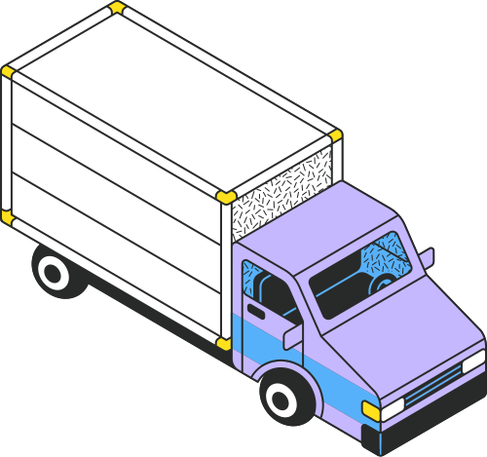
ITS120L - GROUP 6
AI-TRACK: TRANSIT TRACKER
CONCEPTION, LABAY, AGUSTIN, MOLINOS

Slide 2
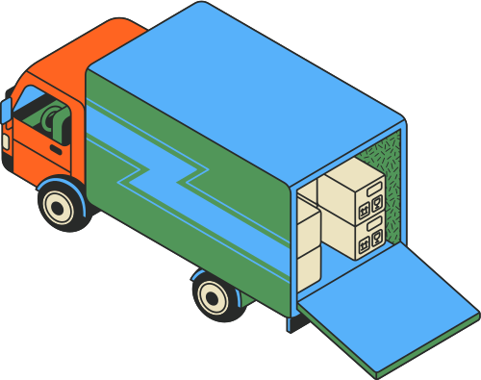
THE PROBLEM
The problem faced by transportation-related websites is the lack of real-time tracking of public transport vehicles, except for ride-hailing apps such as Grab and Angkas. Sakay.ph and the likes only show routes, and plenty of these have outdated information and no real-time tracking.

Slide 3
THE SOLUTION
The solution is in the form of a website-hosted application that primarily tracks public transport such as buses, jeeps, trains, and UV express. In the future, non-ride-hailing taxis will be considered for real-time tracking.

Slide 4

BENEFITS
Ease of transport due to updated route information
Ease of tracking vehicles for various companies
Accessible database of vehicle and driver information
User Convenience offers personalized alerts for delays, route changes, or estimated arrival times.

Slide 5


WHAT MAKES US DIFFERENT
What makes us different is the fact that, instead of the web-hosted app being exclusively for private taxis, the app tracks most forms of public transportation throughout the country.
AI-assisted real-time transportation tracking
Centralized database for vehicles and drivers
Community-driven feedback for users
Scalability

Slide 6
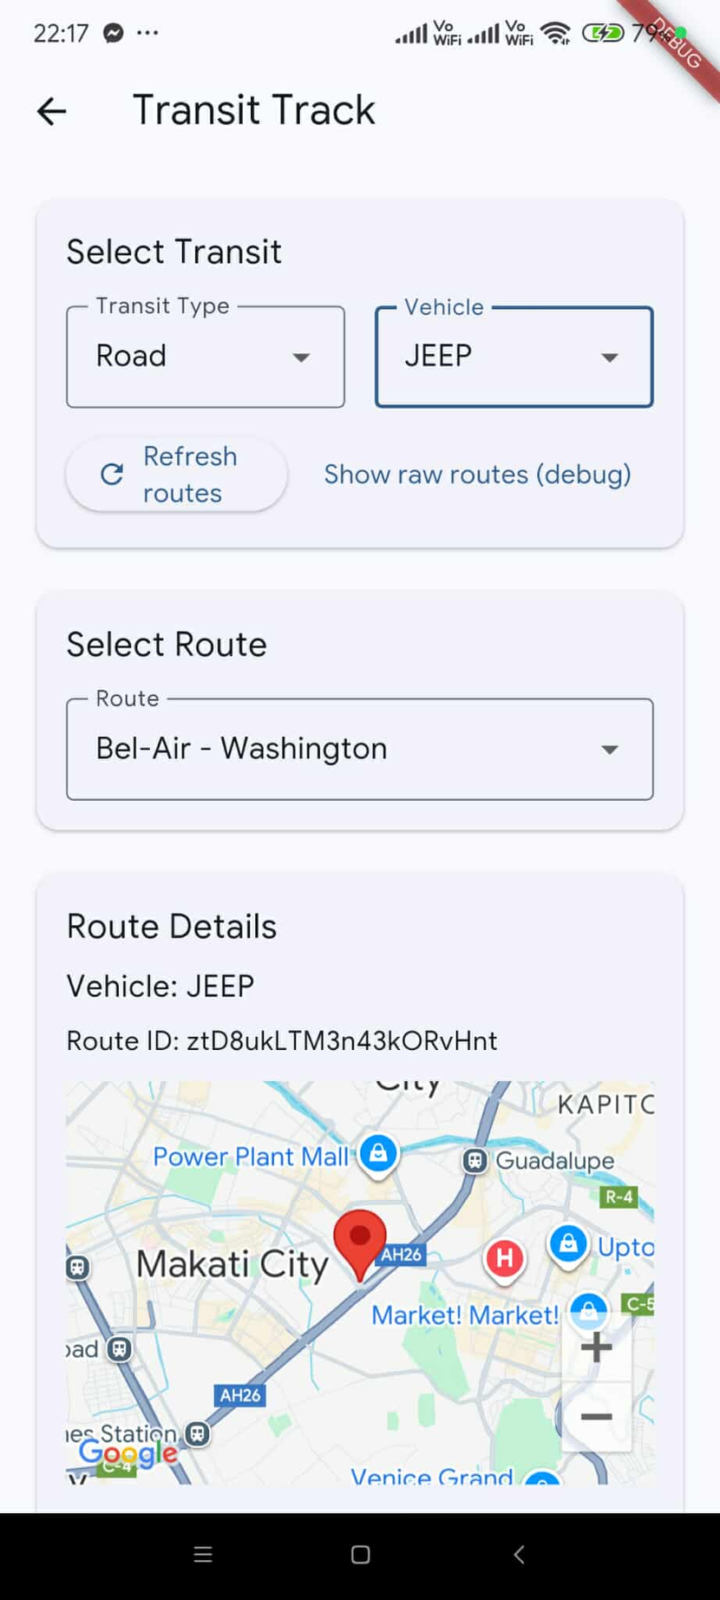
FEATURE 1
REAL-TIME TRACKING
AI-Track: Transit Tracker enables real-time tracking of registered public transport vehicles such as buses, jeeps, and trains through GPS integration and AI-driven analytics.

Slide 7
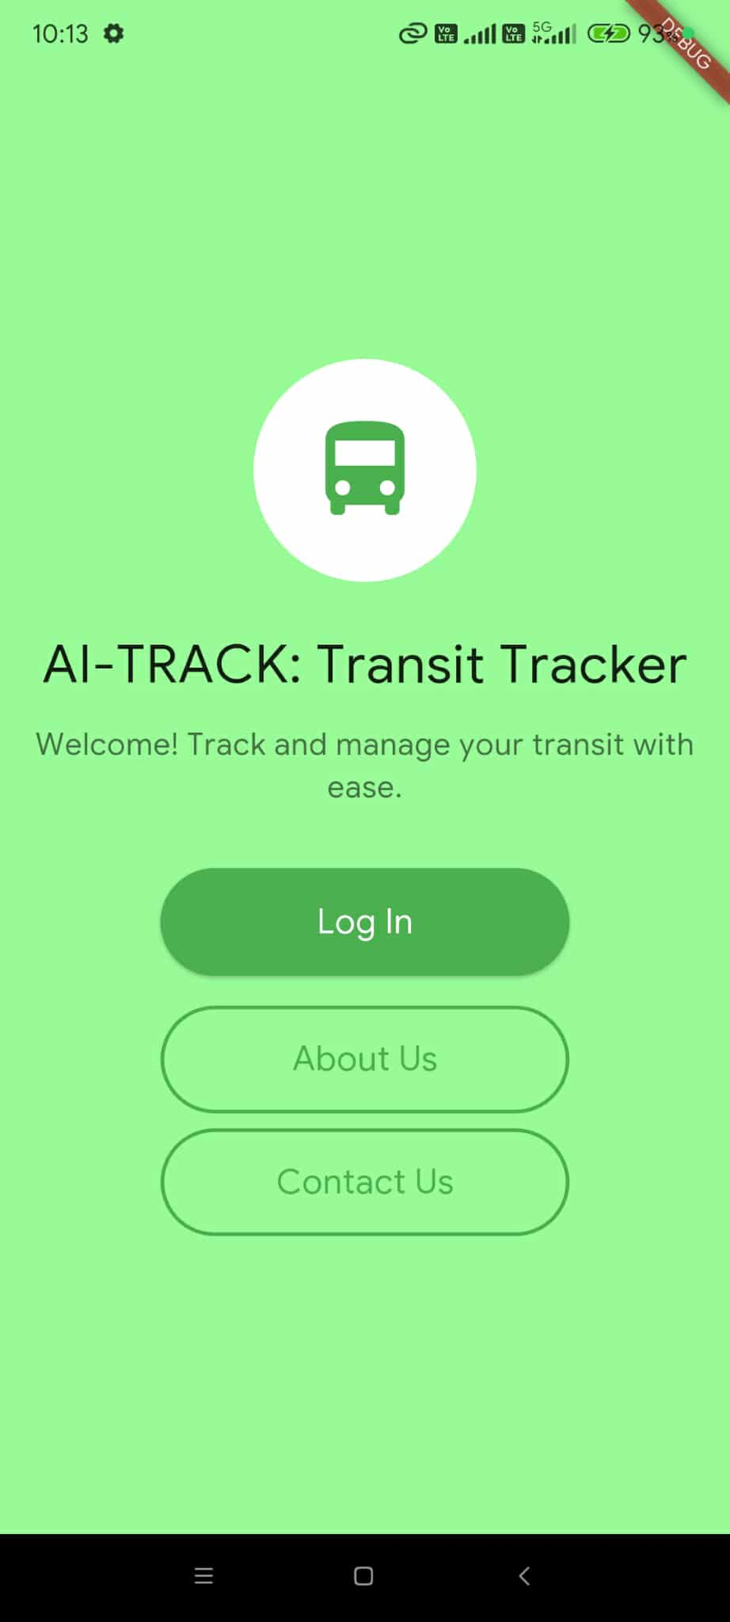
FEATURE 2
SECURITY PT1
Secure Database for AI-Track ensures that all sensitive information, such as driver profiles, vehicle details, and route assignments, is stored safely using encrypted storage and access controls. Only authorized personnel can access or modify this data, protecting against unauthorized breaches or data leaks.

Slide 8
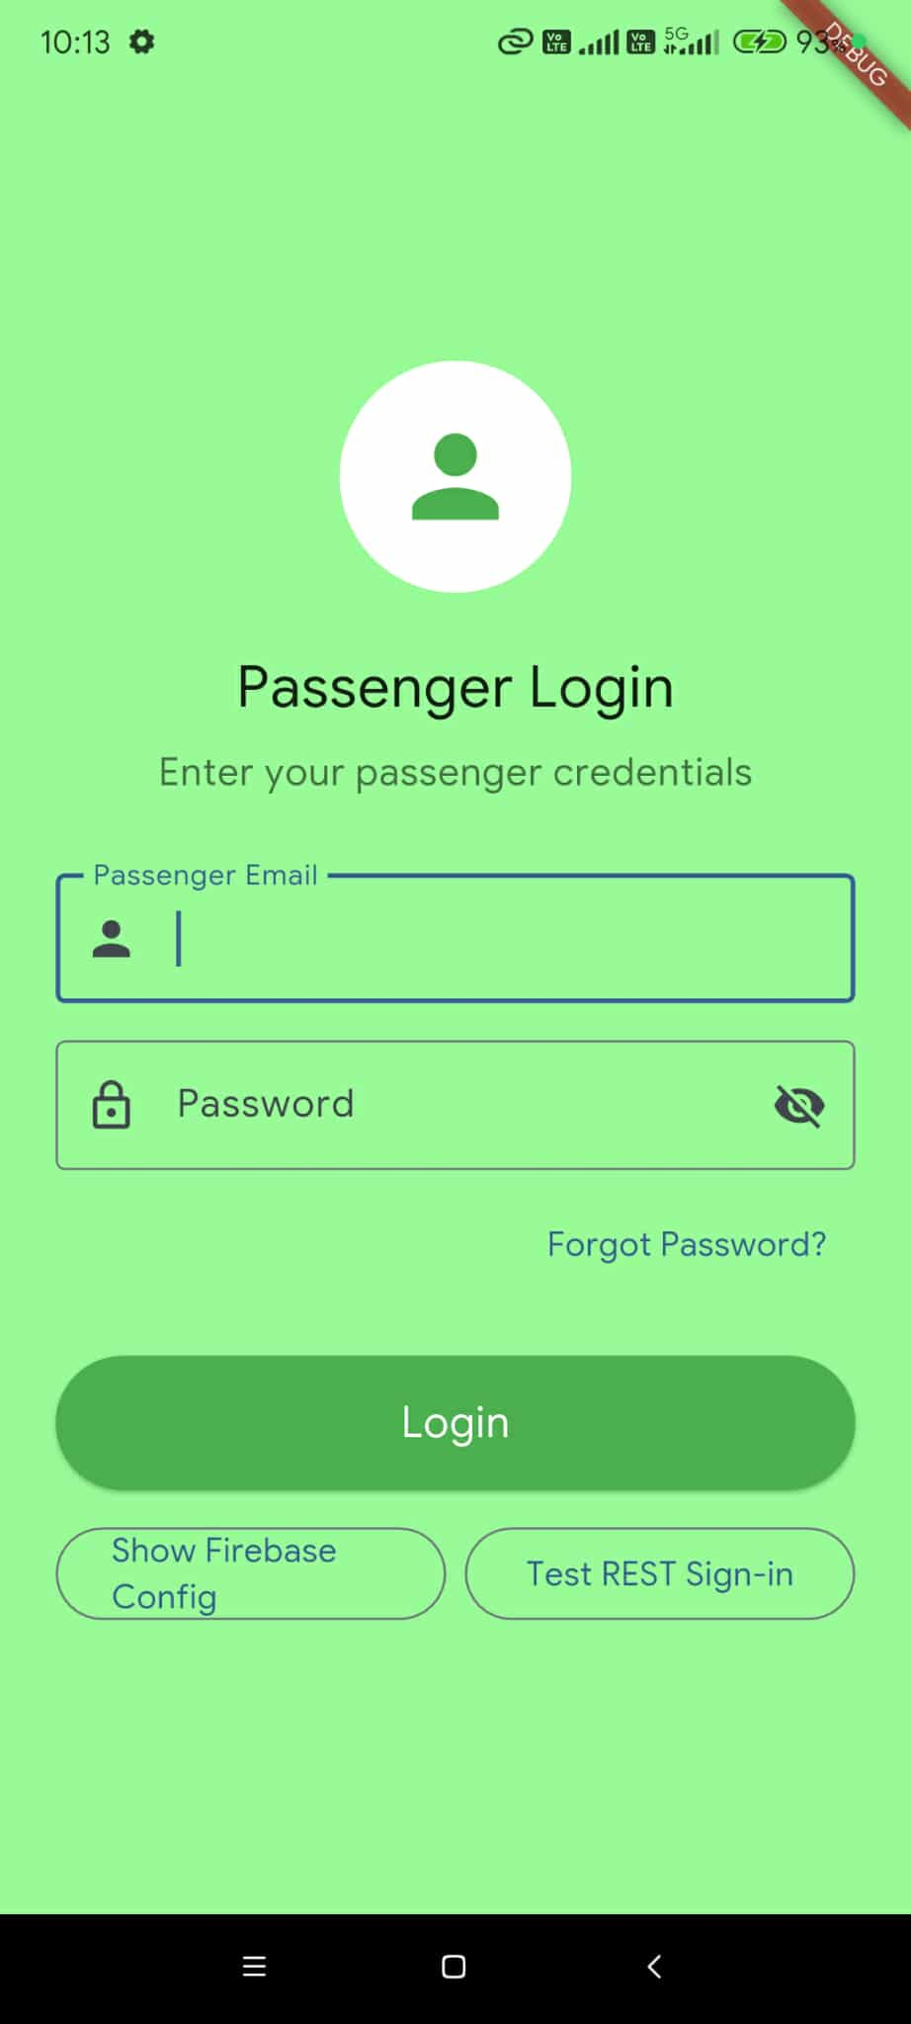
FEATURE 2
SECURITY PT2
Users, also known as Passengers, can log into the app and avail of its services by using a passenger email and a password. This information is stored on the cloud database utilized by the application.

Slide 9
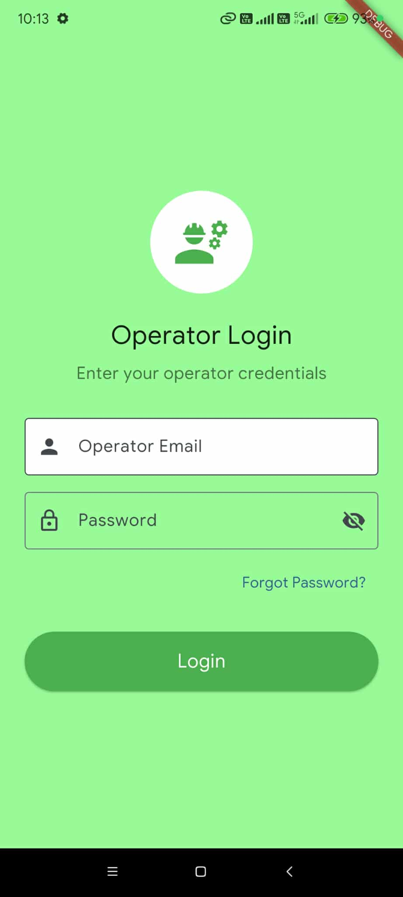
FEATURE 2
SECURITY PT3
Operators have their own separate log in screen that similarly has an operator email and password linked to each account. Data is similarly stored on the cloud database.

Slide 10
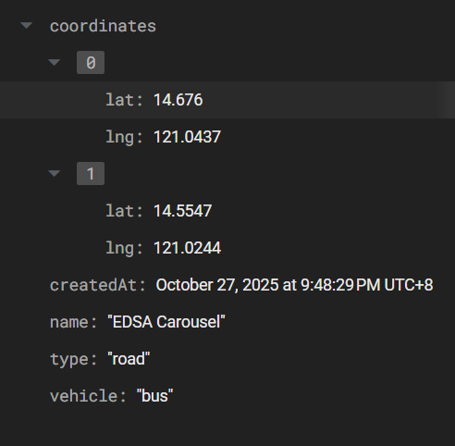
FEATURE 3
CLOUD-BASED DATABASE
Information stored on the application is sent over towards the cloud database for viewing by database administrators and partner organizations such as LGUs and government bodies.

Slide 11
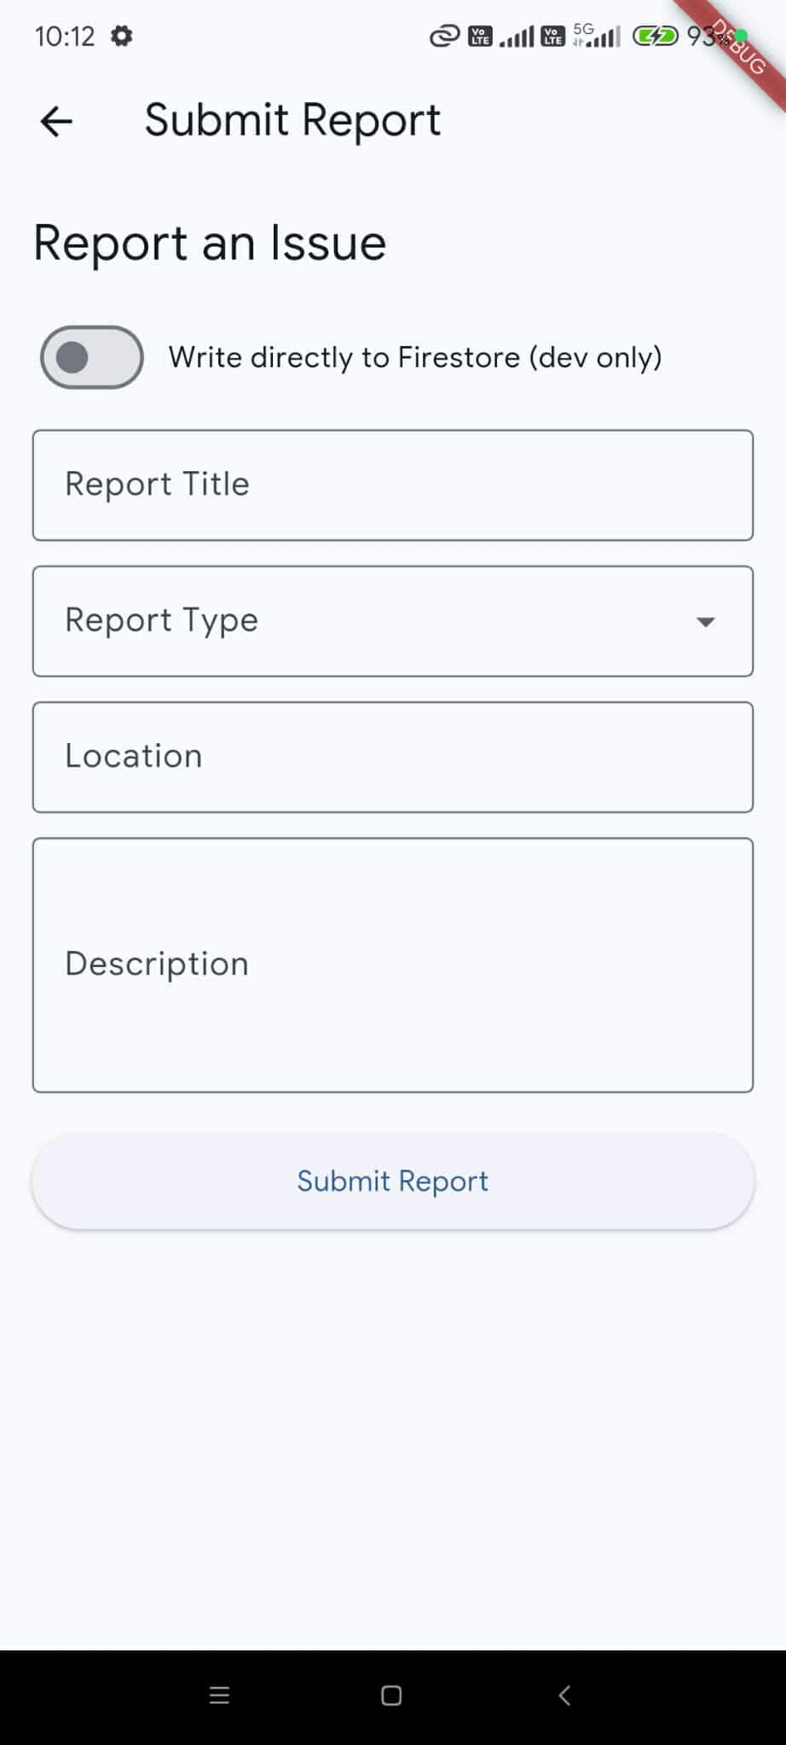
FEATURE 4
REPORT ISSUE FUCNTION
Users are allowed to report any inconveniences or issues with their experience. The user can fill out the following metrics for their report.

Slide 12
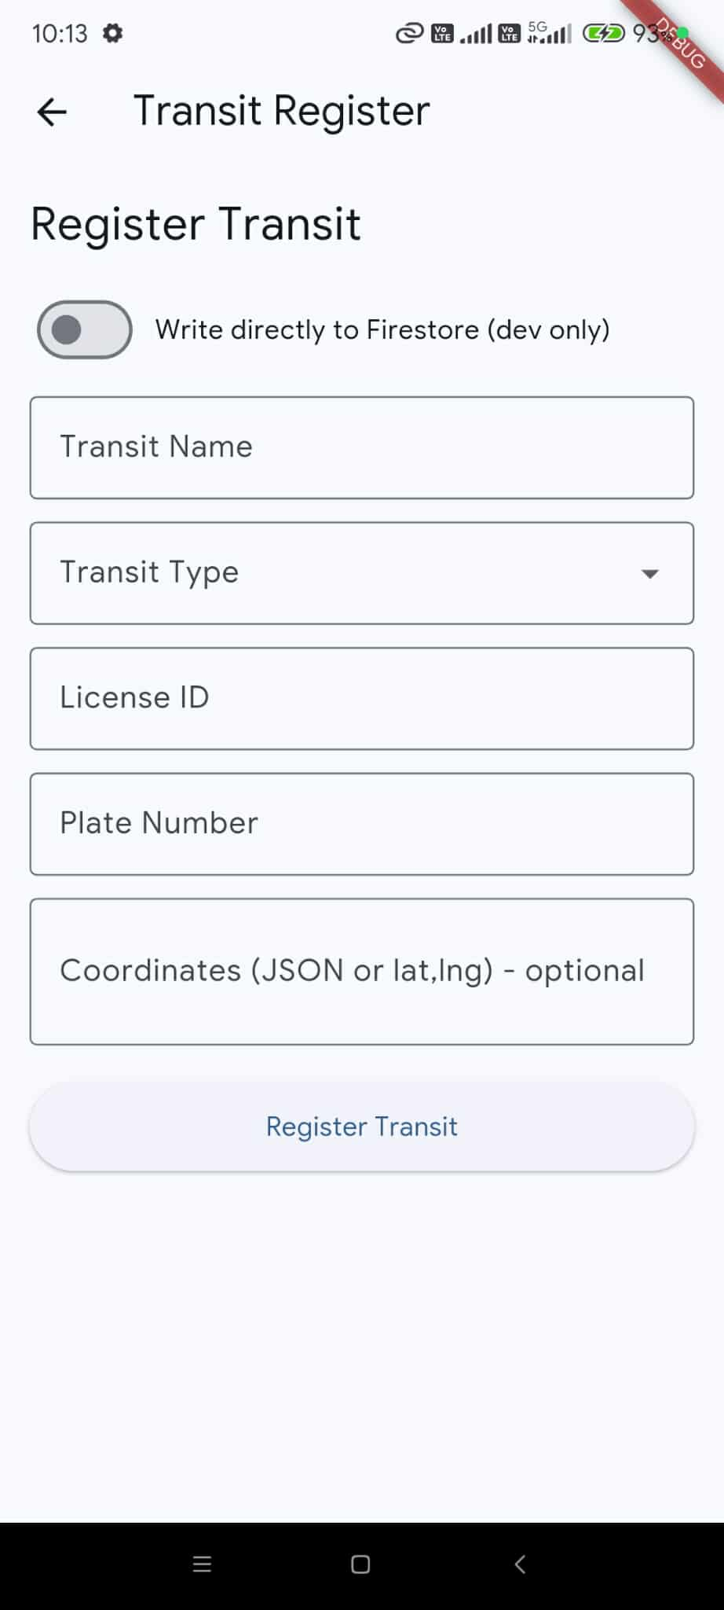
FEATURE 5
REGISTER TRANSIT FUCNTION
Operators can manually register a transit route via the application, inputting transit name, type, license ID, vehicle plate number and optional coordinates.

Slide 13
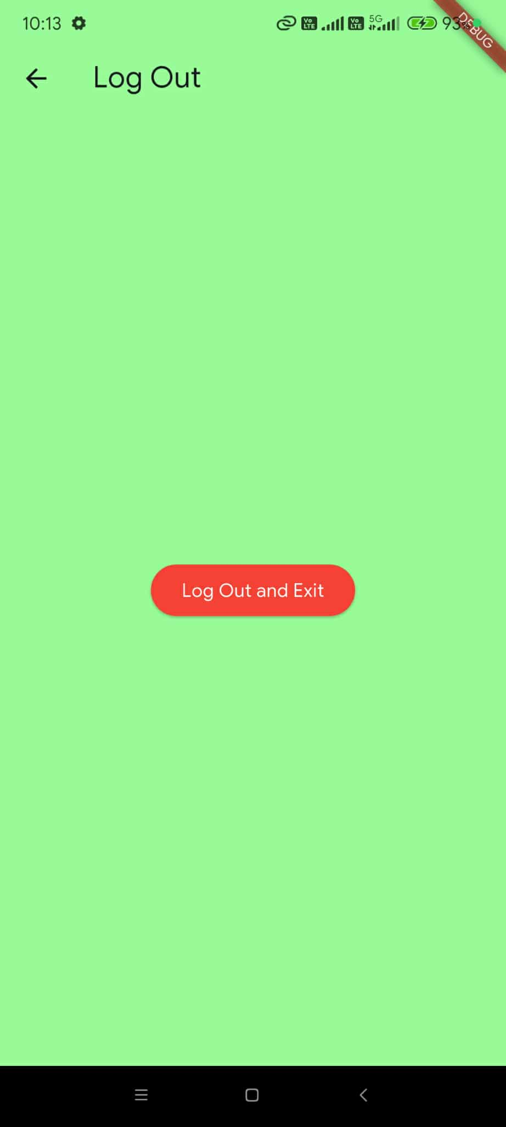
FEATURE 6
LOG OUT AND EXIT SCREEN
Users can log-out and exit the app from the log out and exit screen to terminate their current session.

Slide 14

ITS120L - GROUP 6
THANK YOU
CONCEPTION, LABAY, AGUSTIN, MOLINOS

